Slide 1
CHOLINERGIC SYSTEM AND CHOLINERGIC DRUGS
Dr. KHAN
IMU..BISHKEK KYRGYZSTAN

Slide 2
Sympathetic Vs Parasympathetic
SYMPATHETIC
Fight or Flight
Increase BP & HR, glucose, perfusion
to skeletal muscles, Mydriasis, Bronchodilatation
PARASYMPATHETIC
Rest and Digest
Miosis, decreased HR, BP, bronchia secretion, Insulin release, Digestion, excretion

Slide 4
Sites of Cholinergic Transmission - Summary
Acetylcholine (ACh) is major neurohumoral transmitter at autonomic, somatic and central nervous system:
All preganglionic sites (Both Parasympathetic and sympathetic)
All Postganglionic Parasympathetic sites and sympathetic to sweat gland and some blood vessels
Skeletal Muscles
CNS: Cortex, Basal ganglia, spinal chord and others
Parasympathetic Stimulation – Acetylcholine (Ach) release at neuroeffector junction - biological effects
Sympathetic stimulation – Noradrenaline (NA) at neuroeffector junction - biological effects

Slide 5
Cholinergic Transmission – Synthesis:
Cholinergic neurons contain large numbers of small membrane-bound vesicles (containing ACh) concentrated near the synaptic portion of the cell membrane
ACh is synthesized in the cytoplasm from acetyl-CoA and choline by the catalytic action of Choline acetyltransferase (ChAT)
Acetyl-CoA is synthesized in mitochondria, which are present in large numbers in the nerve ending
Choline is transported from the extracellular fluid into the neuron terminal by a Na+- dependent membrane choline cotransporter
(Carrier A). This carrier can be blocked by a
group of drugs called hemicholiniums
The action of the choline transporter is the rate-limiting step in ACh synthesis

Slide 6
Cholinergic Transmission –
Release:
Synthesized, ACh is transported from the cytoplasm into the vesicles by an antiporter that removes protons (carrier B). This transporter can be blocked by vesamicol
Release is dependent on extracellular Ca²⁺
and occurs when an action potential reaches the terminal and triggers sufficient influx of Ca²⁺ions
The increased Ca²⁺concentration "destabilizes"
the storage vesicles by interacting with special proteins associated with the vesicular membrane (VAMPs and SNAP- synaptosome associated
protein)
Fusion of the vesicular membranes with the terminal membrane results in exocytotic expulsion of ACh into the synaptic cleft
The ACh vesicle release process is blocked by botulinum toxin through the enzymatic removal of two amino acids from one or more of the fusion proteins. Black widow spider??

Slide 7
Cholinergic Transmission: Destruction
After release - ACh molecules may bind to and activate an ACh receptor (cholinoceptor)
Eventually (and usually very rapidly), all of the ACh released will diffuse within range of an acetylcholinesterase (AChE) molecule
AChE very efficiently splits ACh into choline
and acetate, neither of which has significant transmitter effect, and thereby terminates the action of the transmitter.
Most cholinergic synapses are richly supplied with AChE; the half-life of ACh in the
synapse is therefore very short. AChE is also found in other tissues, eg, red blood cells.
Another cholinesterase with a lower
specificity for ACh, butyrylcholinesterase [pseudo cholinesterase], is found in blood plasma, liver, glial, and many other tissues

Slide 8
True Vs Pseudo AChE
True AChE
All cholinergic sites, RBCs, gray matter
Pseudo AChE
Plasma, liver, Intestine and white matter
Distribution
Action on: Acetycholine Methacholine Function
Very Fast Slower
Termination of Ach actio
Slow
Not hydrolyzed
Hydrolysis of Ingested Esters
More sensitive to Organophosphates
Inhibition
More sensitive to Physostigmine

Slide 9
Cholinergic receptors - 2 types
• Muscarinic (M) and Nicotinic (N)
:
Nicotinic (N) – ligand gated
Muscarinic ( M)
- GPCR

Slide 10
Muscarinic Receptors ??
1. Selectively stimulated by Muscarine and blocked by Atropine – all are G- protein coupled receptors
2. Primarily located in autonomic effector cells in heart, eye, smooth muscles
and glands of GIT and CNS
Subsidiary M receptors are also present in ganglia for modulation – long lasting late EPSP
Autoreceptors (M type) are present in postganglionic prejunctional cholinergic Nerve endings – inhibits ACh release
also in adrenergic nerve terminals (inhibits NA release) leading to vasodilatation when ACh is injected
Blood vessels: All blood vessels have muscarninc receptors although no cholinergic innervations – EDRF – SM relaxation - Vasodilatation

Slide 11
Muscarinic Receptors - Subtypes
Pharmacologically - M1, M2, M3, M4 and M5
M4 and M5 are present in certain areas of Brain and regulate other neurotransmitters
M1, M3 and M5 fall in one class, while M2 and M4 in another class
However - M1, M2 and M3 are major ones and present in effector cells and prejunctional nerve endings in Peripheral organs and CNS
All subtypes have little agonist selectivity but selective antagonist selectivity
Most organs usually have more than one subtype but one subtype predominates in a tissue

Slide 12
Muscarinic Receptors - Location
•
M1: Autonomic ganglion Cells, Gastric glands and Central Neurons (cortex, hippocampus, corpus striatum)
Physiological Role: Mediation of Gastric acid secretion and relaxation of LES (vagal)
Learning, memory and motor functions
•
M2: Cardiac Muscarinic receptors
•
•
•
Mediate vagal bradycardia
Also auto receptors in cholinergic nerve endings CNS – Tremor, analgesia
•
M3: Visceral smooth muscles, glands and vascular endothelium. Also Iris and Ciliary muscles

Slide 13
Muscarinic Receptor Subtypes
M 1
Autonomic ganglia, Gastric glands and CNS
Depolarization (late
EPSP) & Histamine release & acid secretion, relaxation of LES, CNS learning and motor functions
M 2
Heart and CNS
M 3
SMs of Viscera, Eye, exocrine glands and endothelium Visceral SM contraction, glandular secretions,
Constriction of pupil, contraction of Cilliary muscle and
vasodilatation (EDRF
⁻B^{N}et^{O}h⁾anechol Darifenacin
Location
Functions
Less impulse generation, less velocity of conduction, decreased contractility, less ACh release (auto)
Agonists Antagonists
Oxotremorine Pirenzepine
Methacholine
Methoctramine & Triptramine
K+ channel opening and decresed cAMP
Transducer
IP3/DAG and PLA2
increase – Ca++ and PG
IP3/DAG and increase – Ca++ and PG synthesis

Slide 14
Acetylcholine (cholinergic receptors)
– Muscarinic Receptors
Selectively stimulated by Muscarine and blocked by Atropine
M1
Ganglia, gastric
gland and CNS
M2
Heart
Cholinergic Nerves
M3
Visceral Smooth Muscles, Iris and cilliary muscle

Slide 15
Nicotinic (N) Receptors
Nicotinic receptors: nicotinic actions of ACh are those that can be reproduced by the injection of Nicotine (Nicotiana tabacum)
Can be blocked by tubocurarine and hexamethonium
Ligand-gated ion channels
activation results in a rapid increase in cellular permeability to Na+ and Ca++ resulting - depolarization and initiation of action potential
TWO Types: NM and NN – based on location
•
•

Slide 16
Question ?
A person is having severe cholinergic symptoms like vomiting, salivation and lacrimation etc. after accidental consumption of poisonous mushroom. What subtype of receptor is involved in the mediation of such reaction
….. ????
Answer: M3

Slide 17
Question…?
What side effects might you expect to see in a patient taking a cholinergic drug?
Hint…
• = “Colon-Urgent” ….Cholinergic

Slide 18
Cholinergic Drugs or Cholinomimetic or
Parasympathomimetics
Drugs producing actions similar to Acetylcholine by – 1) interacting with Cholinergic receptors or 2) increasing availability of
Acetylcholine at these sites

Slide 19
Classifiction - Direct-acting (receptor agonists)
M agonist :>>.. N agonist Mixed acting
Muscarin, nicotine methacholine
bethonichol acetylcholine
Pilocarpin carbachol
•
•

Slide 20
Cholinergic Drugs – Indirect acting
Reversible
Natural: Physostigmine
Synthetic: Neostigmine, Pyridostigmine,, Rivastigmine, Donepezil,, Edrophonium,,
Irreversible anticholinesterases:
Organophosphorous Compounds (OPC) – Diisopropyl fluorophosphate (DFP), Ecothiophate, Parathion, malathion, diazinon (insecticides and pesticides)
Tabun, sarin, soman (nerve gases in war)

Slide 21
Pilocarpine
Alkaloid from leaves of Jaborandi (Pilocarpus microphyllus)
Prominent muscarinic actions
Profuse salivation, lacrimation, sweating
Dilates blood vessels, causes hypotension
High doses: Rise in BP and tachycardia (ganglionic action)
On Eyes: produces miosis and spasm of accommodation
Lowers intraocular pressure (IOP) in Glaucoma when applied as eye drops
Too toxic for systemic use – CNS toxicity
Diaphoretic (?), xerostomia and Sjögren’s syndrome

Slide 22
Pilocarpine – contd.
Used as eye drops in treatment of
narrow angle glaucoma to reduce IOP
To reverse mydriatic effect of atropine
To break adhesion between iris and cornea/lens alternated with mydriatic
Pilocarpine nitrate eye drops ( 1 to 4% )
Atropine used as antidote in acute pilocarpine poisoning ( 1-2 mg IV 8 hrly )
•
•

Slide 23
IMU ,,,dr khan

Slide 24
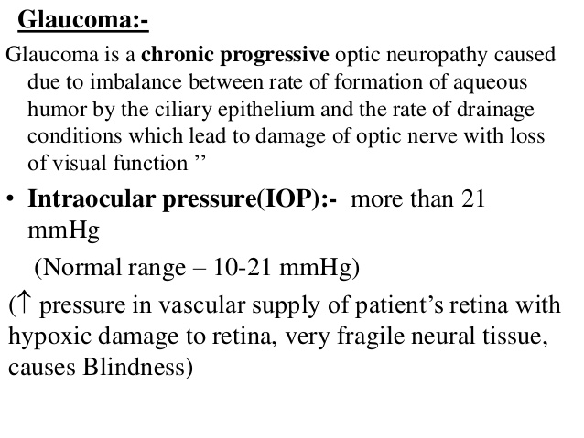
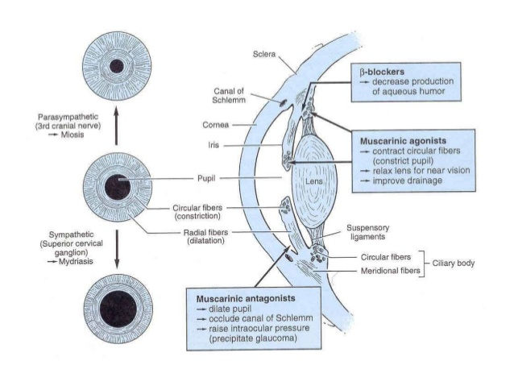
Pilocarpine in Glaucoma
•
•
•
Constriction of circular muscle of Iris Contraction of ciliary muscle
Spasm of accommodation – fixed at near vision

Slide 25
Muscarine
Alkaloid from mushroom Amanita muscaria
Only muscarinic actions
No clinical use
Mushroom poisoning due to ingestion of poisonous mushroom
1.Early onset mushroom poisoning (Muscarine type) inocybe and clitocybe 2.Late onset mushroom poisoning aminata phallides 3.Hallucinogenic type aminata muscira

Slide 26
Mushroom Poisoning
Early Onset Mushroom Poisoning: Occurs ½ to 1 hour
Symptoms are characteristic of Muscarinic actions
Inocybe or Clitocybe – severe cholinergic symptoms like vomiting, salivation, lacrimation, headache, bronchospasm, diarrhoea bradycardia, dyspnoea, hypotension, weakness, cardiovascular collapse, convulsions and coma
Antidote is Atropine sulphate ( 2-3 mg IM every hrly till improvement)
Hallucinogenic type:amanita muscira due to Muscimol or ibotenic acid present in A. muscria. Blocks muscarinic receptors in brain and activate amino acid receptors. No specific treatment – Atropine contraindicated.

Slide 27
Late Onset Mushroom Poisoning
Occurs within 6 - 15 hours
Amanita phylloides (deadly nightcap), Galerina– due to peptide toxins – Inhibit
RNA and protein synthesis
Irritability, restlessness, nausea, vomiting, bloody diarrhoea ataxia, hallucination,
delirium, sedation, drowsiness and sleep – Kidney, liver and GIT mucosal damage
Maintain blood pressure, respiration
Inj. Diazepam 5 mg IM
Atropine contraindicated as it may cause convulsions and death - penicillin, thioctic acid and silibinin (antidote?)
Gastric lavage and activated charcoal
DELAYED ONSET Type (more than 24 Hours) – Nephrotoxic syndromes

Slide 29
AChEs - MOA
•
•
•
•
Normally Acetylcholinesterase (AchE) hydrolyses
Acetylcholine
The active site of AChE is made up of two subsites – anionic and esteratic
The anionic site serves to bind a molecule of ACh to the enzyme
Once the ACh is bound, the hydrolytic reaction occurs at a second region of the active site called the esteratic subsite
The AChE itself gets acetylated at serine site
Acetylated enzyme reacts + water = acetic acid and choline
Choline - immediately taken up again by the high affinity choline uptake system presynaptic membrane
•
•
•
Tryptophan
Glutamate and histidine

Slide 30
AChEs - MOA
Anticholinesterases also react with the enzyme ChEs in similar fashion like Acetylcholine
Carbamates – carbamylate the active site of the enzyme
Phosphates – Phosphorylate the enzyme
Both react similar fashion covalently with serine
Carbamylated (reversible inhibitors) reacts with water slowly and the esteratic site
is freed and ready for action – 30 minutes (less than synthesis of fresh enzyme)
But, Phosphorylated (irreversible) reacts extremely slowly or not at all – takes more
time than synthesis of fresh enzyme
– Sometimes phosphorylated enzyme losses one alkyl group and become resistant to
hydrolysis – aging
Edrophonium and tacrine react only at anionic site – short acting while
Organophosphates react only at esteratic site

Slide 31
Physostigmine
Alkaloid from dry ripened seed (Calabar bean) of African plant Physostigma venenosum
Tertiary amine, lipid soluble, well absorbed orally and crosses BBB
Hydrolyzed in liver and plasma by esterases
Long lasting action (4-8 hours)
Penetrates cornea readily on local application in eye - Muscarinic action on eye causing miosis and spasm of accommodation on local application
Salivation, lacrimation, sweating and increased tracheobronchial secretions
Increased heart rate & hypotension

Slide 32
Physostigmine - uses
Used as miotic drops to decrease IOP in Glaucoma
To antagonize mydriatic effect of atropine
To break adhesions between iris and cornea alternating with mydriatic drops
Belladonna poisoning, TCAs & Phenothiazine poisoning
Alzheimer’s disease- pre-senile or senile dementia
Atropine is antidote in physostigmine poisoning.
ADRs – CNS stimulation followed by depression

Slide 33
Neostigmine
Synthetic reversible anticholinesterase drug
Quaternary ammonium compound and lipid insoluble
Cannot cross BBB
Hydrolysed by esterases in liver & plasma
Short duration of action (3-5 hours)
Direct action on nicotinic (NM) receptors present in neuromuscular junction (motor
end plate) of skeletal muscle
Antagonises (reverses) skeletal muscle relaxation (paralysis) caused by
tubocurarine and other competitive neuromuscular blockers
Stimulates autonomic ganglia in small doses - Large doses block ganglionic
transmission
No CNS effects

Slide 34
Neostigmine – Uses and ADRs
Used in the treatment of Myasthenia Gravis to increase muscle strength
Post-operative reversal of neuromuscular blockade
Post-operative complications – gastric atony paralytic ileus, urinary bladder atony
Cobra snake bite
Produces twitchings & fasciculations of muscles leading to weakness
Atropine is the antidote in acute neostigmine poisoning

Slide 35
Physostigmine Vs Neostigmine
Physostigmine
Natural Tertiary amine
Neostigmine
Synthetic
Quaternary ammonium compound
Poor
Absent
Poor penetration Muscle Mysthenia gravis
0.5-2.5 mg IM/SC
15-30 mg orally
3-4 Hrs
Source Chemistry
Oral absorption CNS action Eye
Effect Uses
Dose
Good Present
Penetrates cornea Ganglia
Miotic
0.5-1 mg oral/parenteral
0.1-1% eye drop
4-6 Hrs
Duration of action

Slide 36
Other Drugs
Pyridostigmine: Same as Neostigmine - less potent but longer acting
Edrophonium: Same as Neostigmine – shorter duration of action (1- - 30 minutes) – diagnostic use in MG
Tacrine: Acts like edrophonium, lipid soluble, crosses BBB – increases brain ACh – symptomatic improvement in Alzheimer`s disease (AD)
Rivastigmine, donepezil, galantamine – all used in AD

Slide 37
Myasthenia gravis (Myo + asthenia)
Autoimmune disorder affecting 1 in 10,000 population (?) – reduction in number of NM receptors
Symptoms: Weakness and easy
fatigability – ptosis to diaphragmatic
paralysis
Causes: Development of antibodies
directed to Nicotinic receptors in muscle end plate – reduction in number by 1/3rd of NM receptors
Structural damage to NM junction

Slide 38
Myasthenia gravis – other drugs
Neostigmine – 15 to 30 mg. orally every 6 hrly
Adjusted according to the response
Pyridostigmine – less frequency of dosing
Other drugs: Corticosteroids (prednisolone 30-60 mg /day) – immunosuppression
•
•
Inhibits production of NR antibodies and may increase synthesis or NRs Azathioprin and cyclosporin also Plasmapheresis

Slide 39
Myasthenic crisis
Acute weakness and respiratory paralysis
Tracheobronchial intubation and mechnical ventilation
Methylprednisolone IV with withdrawal of AChE
Gradual reintroduction of AChE
Thymectomy
The problem – overtreatment Vs actual disease (opposite treatments)
Diagnosis by various tests – Tensilon Test
Injection of Edrophonium – 2 mg (observe) – after half a minute 8 mg (observe)
•
•
In MG – symptoms will improve
In overtreatment – symptoms worsen

Slide 40
Overall Therapeutic Uses – cholinergic drugs
Myasthenia gravis: Edrophonium to diagnose and Neostigmine, Pyridostigmine & Distigmine to treat
To stimulate bladder & bowel after surgery:
1.
To improve cognitive function in Alzheimer’s disease: Rivastigmine, Gallantamine, Donepezil.
Physostigmine in Belladonna poisoning
Cobra Bite
–
Bethanechol, Carbachol, Distigmine.
To lower IOP in chronic simple glaucoma:
–
Pilocarpine, Physostigmine

Slide 41
Pharmacotherapy of Organophosphate Poisoning
•
•
Complex effects – Muscarinic, Nicotinic and CNS Signs and symptoms:
1. Irritationof eye, lacrmation, salivation, tracheo-bronchial secretions, colic, blurring of vision,
defaecation and urination
Fall in BP, tachy or bradycardia and CVS collapse
Muscular fasciculations, weakness, and respiratory paralysis
Irritability, disorientation, ataxia, tremor, convulsins and coma
•
Treatment
ABC
Airway amaintance
Breathing Give oxygen
Circulation :”two wide bore calunas then give normal saline
Pass NG tube
Pass foleys catheter
ANTIDOT PRALIDOXIME
Atropine – 2mg IV every 10 minutes till dryness of mouth

Slide 43
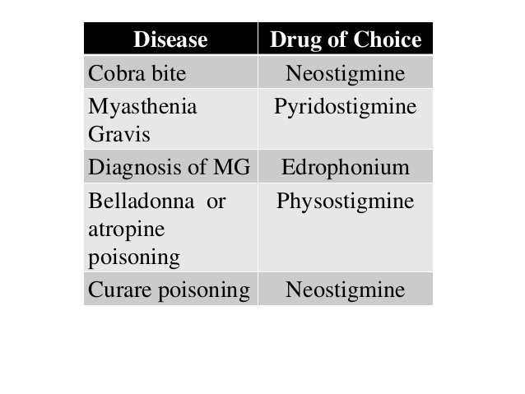
Mukhtiar khan IMU KYRGYSTAN/Thank you

