Slide 1
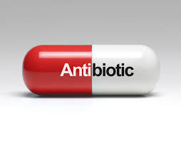
ANTIBIOTICS

